Slide 1
Tic-Tac-Toe Non-AI and AI technique
Dr. Priyadarshan Dhabe,
Ph.D (IIT Bombay)

Slide 2
How to play tic-tac-toe?
Players | Symbol
P1 | X
P2 | O
Initial Board
Turn of P1- will put one X in any blank cell
Turn of P2- will put one O in any blank cell
P1 &P2- Play alternate turns
Winning position-
P1- will try to put all X in any row, column or diagonal
P2- will try to put all O’s in any row, column or diagonal
Max Turns-9

Slide 3
How to play tic-tac-toe?
O
Winning position of P2
O
O
X
Winning position of P1
X
X

Slide 4
How to play tic-tac-toe using Computer ?
Either P1 or P2 will be played by computer
Computer can use two Techniques to play this game by
Non-AI technique
AI technique

Slide 5
Representation of board position in computer memory
0
1
2
1. Using 3x 3 Matrix
3
4
5
6
7
8
2. Using 9 element vector
0
1
2
3
4
5
6
7
8

Slide 6
Non-AI technique
O
O
Using rules
X
For calculations use following values to represent
- Blank- 0 (Zero)
- X- 1 (one)
-O-2 (Two)
O
2
O
O
X
O
1
O
O
O
O
Vector representation
2 | 0 | 0 | 0 | 1 | 0 | 0 | 0 | 0

Slide 7
Non-AI technique
System will prepare a rule base of 3^ 9 rules like
O
O
X
Each 9 element vector is considered as base 3 number to provide an index in rule base
2 | 0 | 0 | 0 | 1 | 0 | 0 | 0 | 0

Slide 8
Non-AI technique
How to use index?
Index | Vector V
1 | [000,000,000]
3^9 | […………………..]

Slide 9
Tic-Tac-Toe game tree
O
O
………....
O
O
O
O
X
O
X
X
………....

Slide 10
Tic-Tac-Toe AI technique
Design two functions
1. Possible move generator
2. Node evaluator
How to select the best possible move?- using scores
Winning- 60
Blocking- 50
Else- No of rows+ cols+ diagonals blocked from winning our opponent

Slide 11
Possible move generator
X
O
X-2
O-1
Next Turn X
O
O
X
2 | 1 | 0 | 1 | 0 | 1 | 0 | 2 | 0
4 X 9 element matrix
2 | 1 | 2 | 1 | 0 | 1 | 0 | 2 | 0
2 | 1 | 0 | 1 | 2 | 1 | 0 | 2 | 0
2 | 1 | 0 | 1 | 0 | 1 | 2 | 2 | 0
2 | 1 | 0 | 1 | 0 | 1 | 0 | 2 | 2

Slide 12
Find all possible moves from the given state and choose best one if it is turn of player X
X
O
O
O
X

Slide 13
Find all possible moves from the given state and choose best one if it is turn of player O
X
O
O
X
O
X

Slide 14
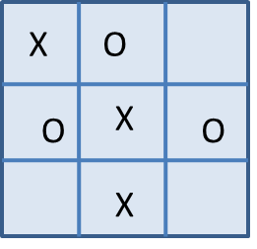
Tic-Tac-Toe using Mini-max
Get input as a valid bard position, there is turn of O
O –is maximizing
X-minimizing
2 ply search
Level 1
-4
-3
-2

Slide 15
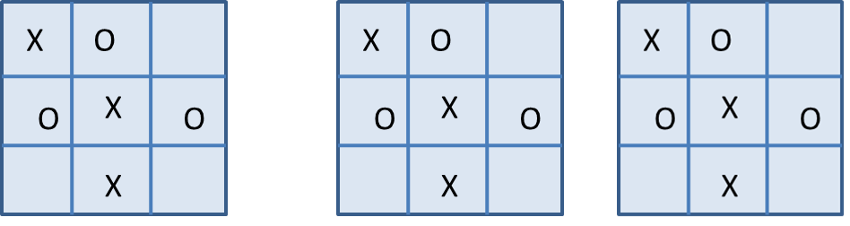
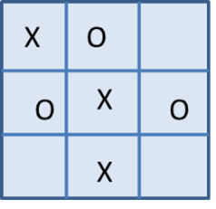
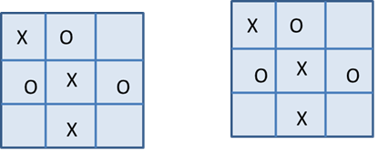
-4
-3
-2
-2
-3
-2
-4
-2
-2
Evaluate each node at level 2 and backup the values
Level 2
Maximizing -O
Winning - +60
Blocking- +50
Else- +sum of R,C, D blocked
Minimizing -X
Winning -- -60
Blocking- -50
Else- - sum of R,C, D blocked

